Slide 1

Real World NLP and DNLP

Slide 2

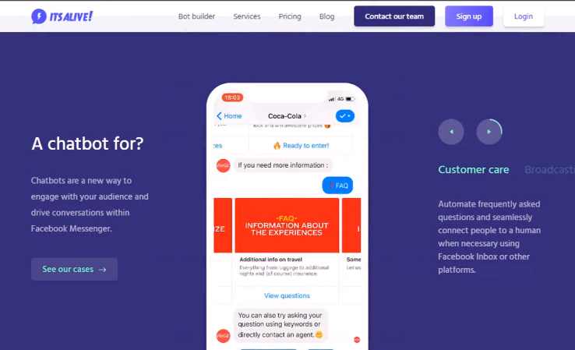
Real World NLP and DNLP

Slide 3
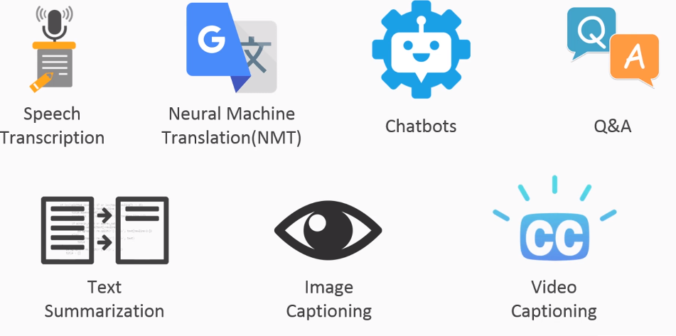
Different Uses OF NLP

Slide 4
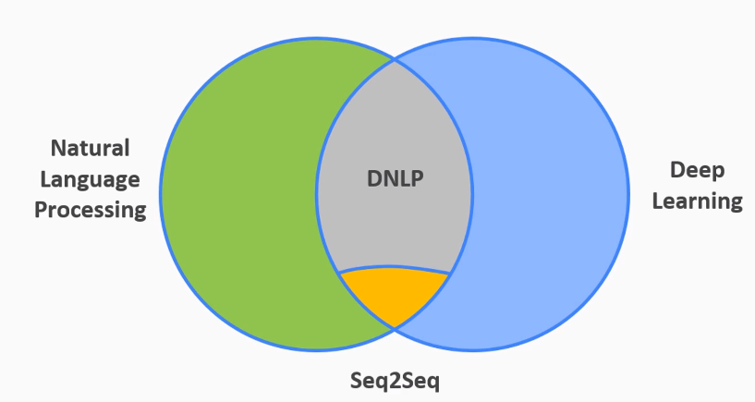
Venn Diagram to Understand NLP,DNLP and Seq2Seq

Slide 5
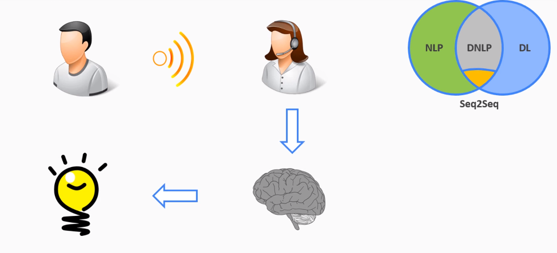
End-to-End Deep Learning Model (Human)

Slide 6
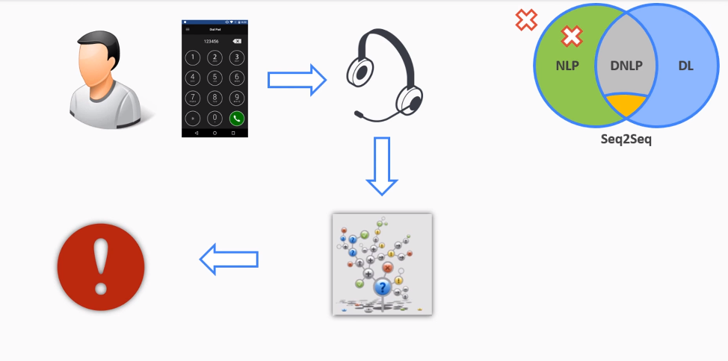
End-to-End Deep Learning Model (If else Machine)

Slide 7
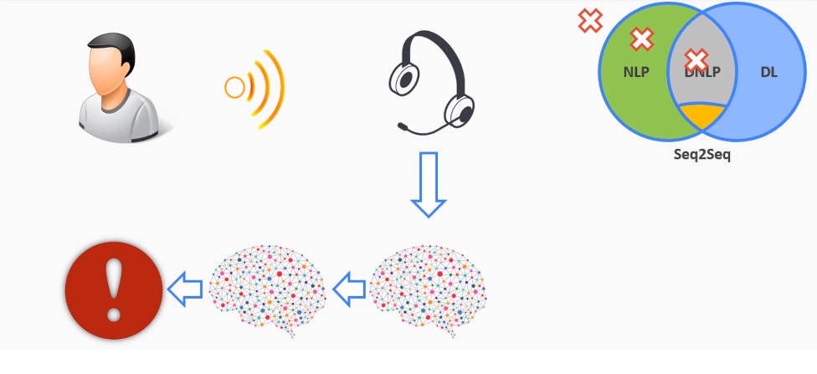
End-to-End Deep Learning Model (If else Machine)

Slide 8
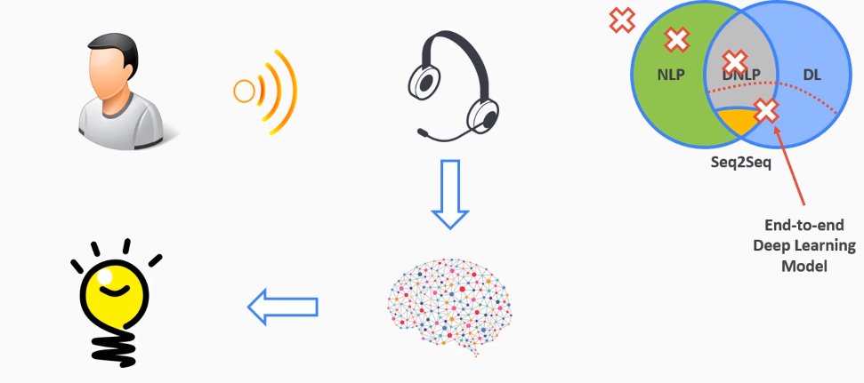
End-to-End Deep Learning Model (If else Machine)

Slide 9
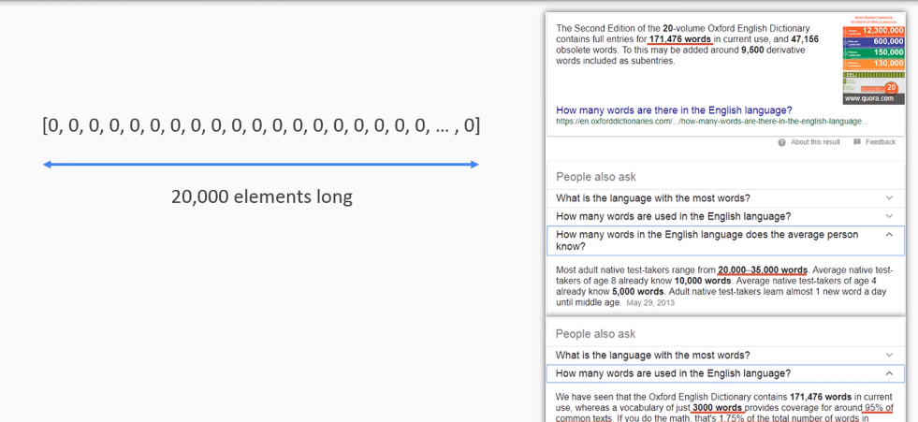
Bag-to-Bag Model

Slide 10
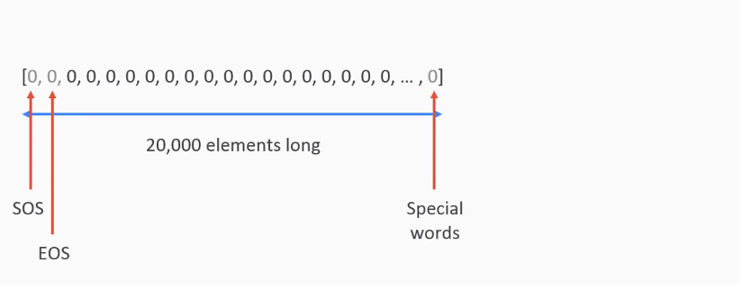
Bag-Of-Words Model

Slide 11
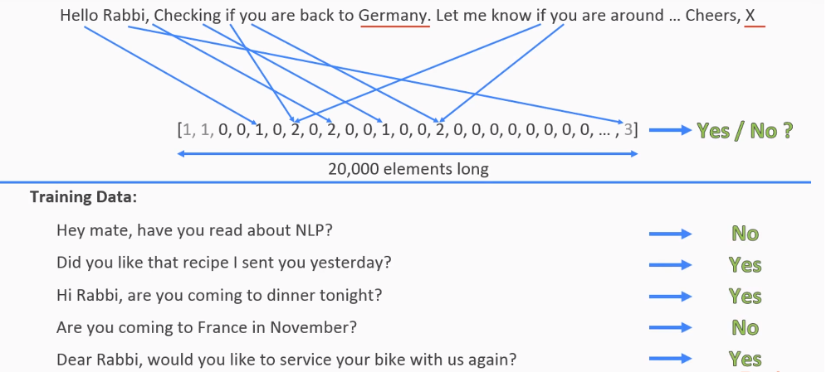
Bag-Of-Words Model

Slide 12
Bag-Of-Words Model

Slide 13
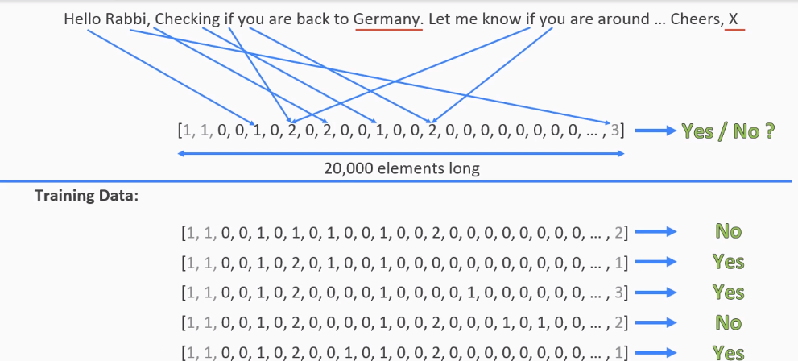
Bag-Of-Words Model

Slide 14
Bag-Of-Words Model

Slide 15
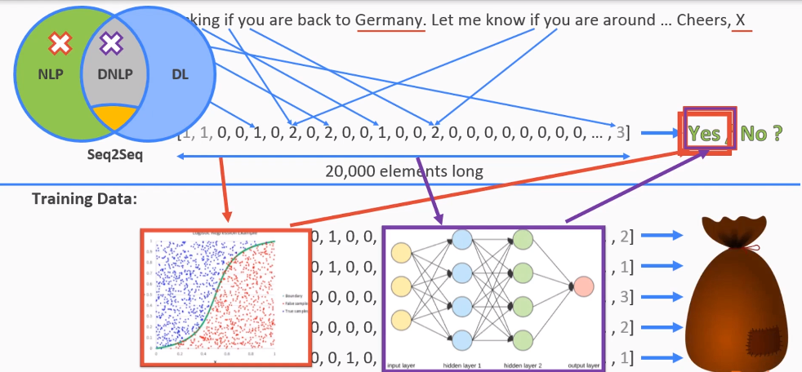
Bag-of-Word Model

Slide 16
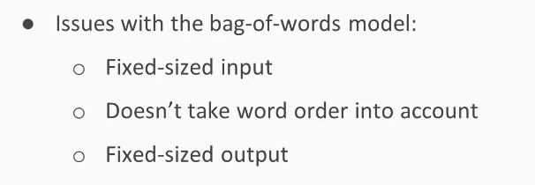
Limitation Of Bag-Of-Words

Slide 17

Sol of Limitation of Bag-Of-Words

Slide 18
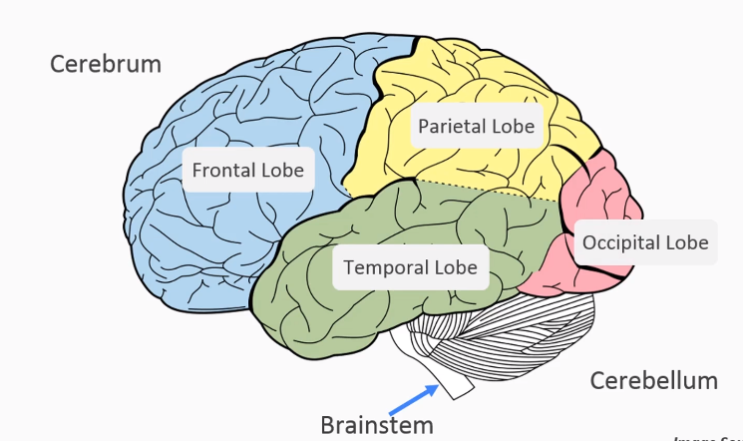
What is RNN?

Slide 19
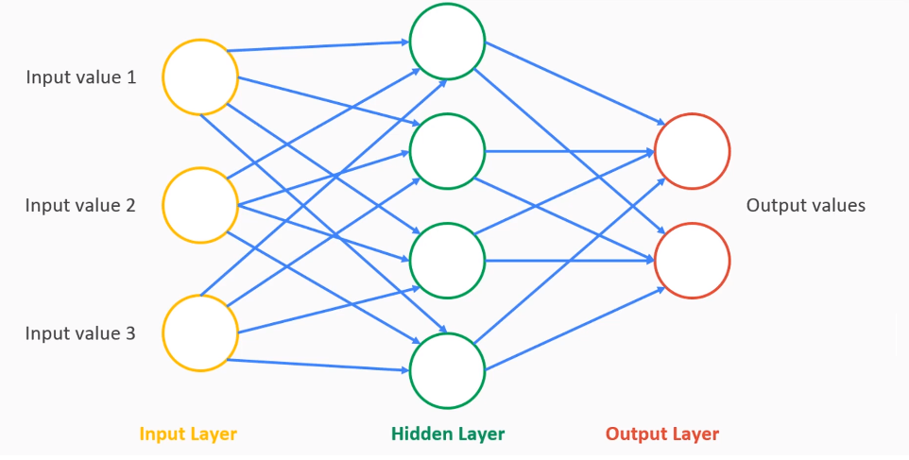
What is RNN?

Slide 20
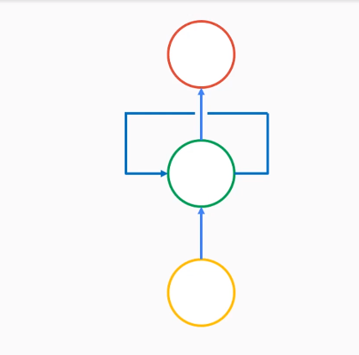
What is RNN (Short term memory)?

Slide 21
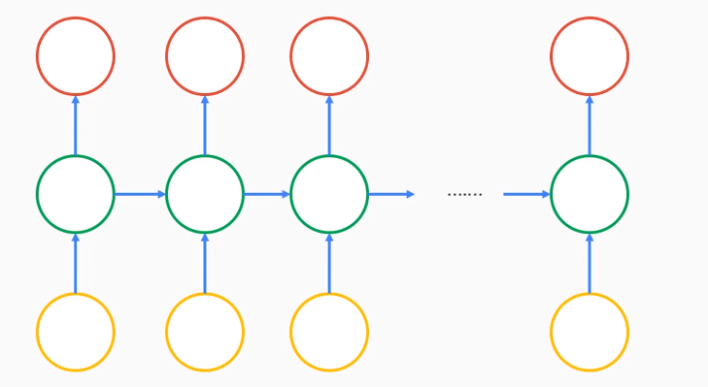
What is RNN (Classic Neural Network)?

Slide 22
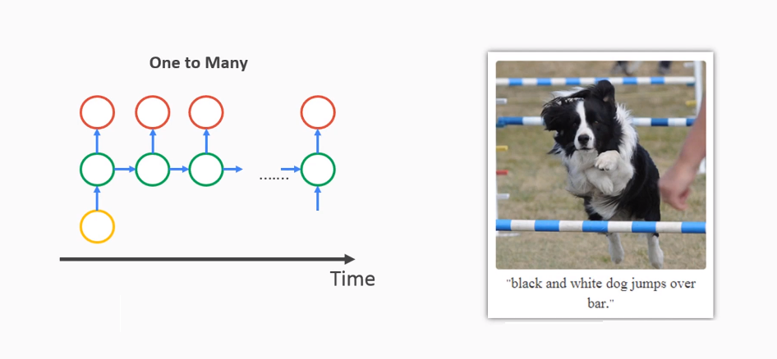
What is RNN (One To Many)?

Slide 23
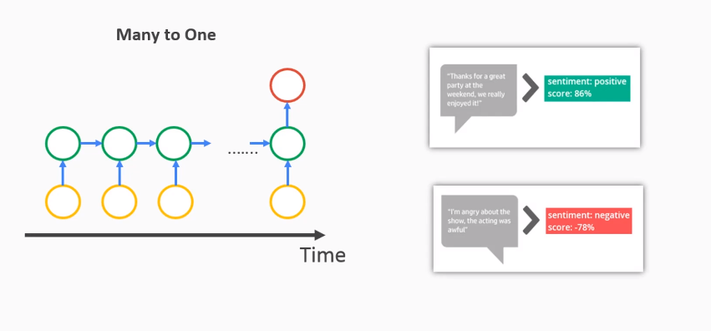
What is RNN (Many To One)?

Slide 24
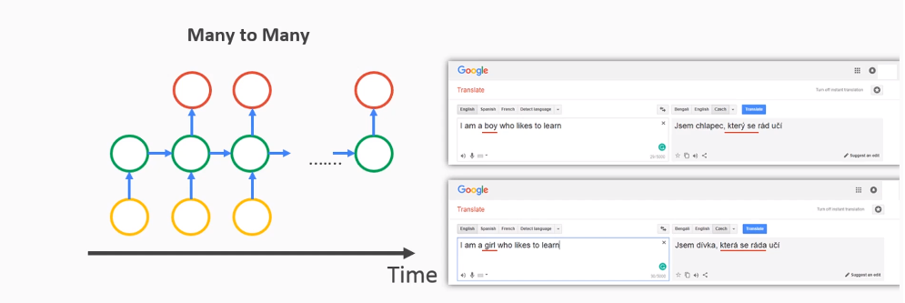
What is RNN (Many To Many)?

Slide 25
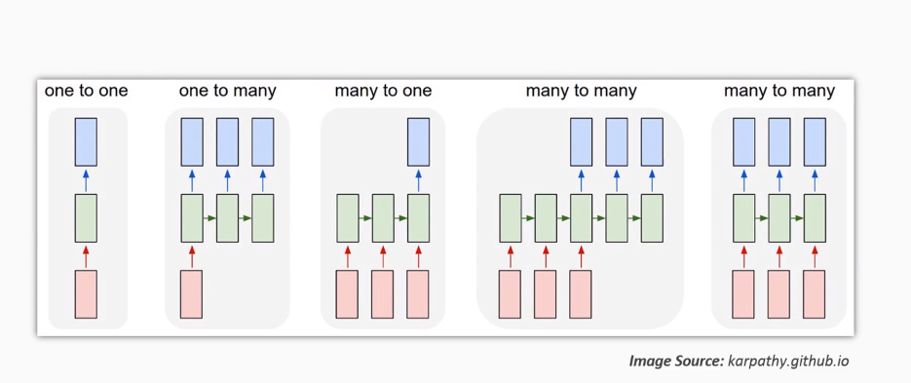
Seq2Seq Model Architecture ?

Slide 26
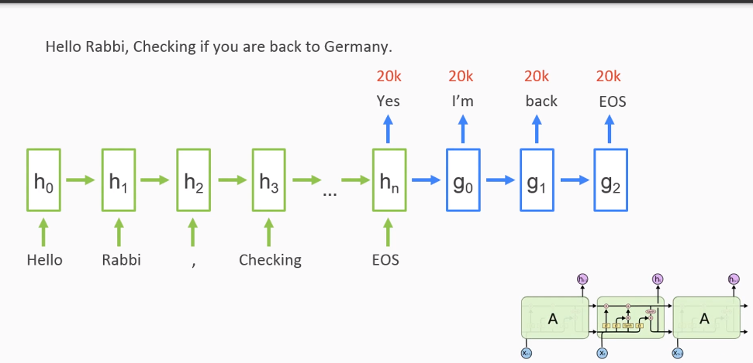
Seq2Seq Model Architecture ?

Slide 27
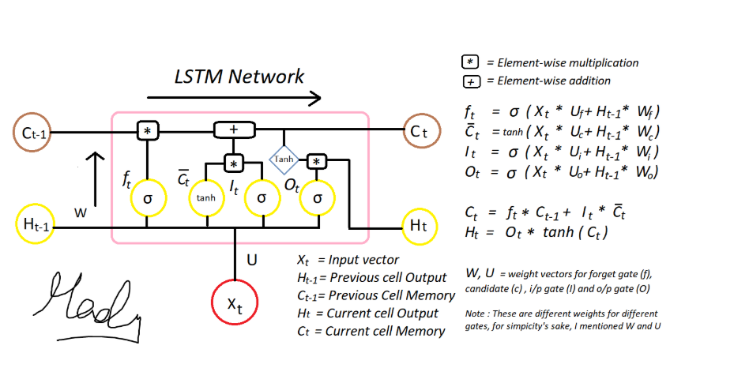
Seq2Seq Model Architecture (LSTM) ?
https://medium.com/deep-math-machine-learning-ai/chapter-10-1-deepnlp-lstm-long-short-term-memory-networks-with-math-21477f8e4235

Slide 28
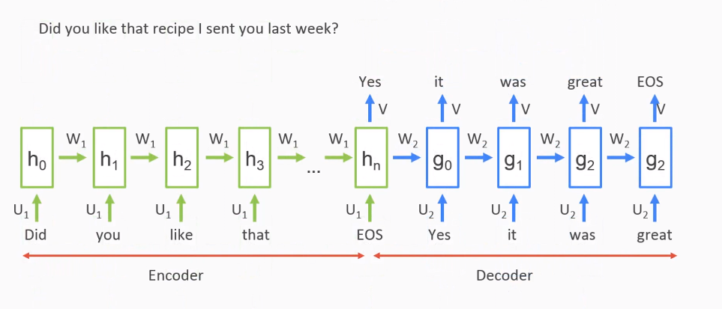
Seq2Seq Model Architecture (How it Works ?) ?

Slide 29
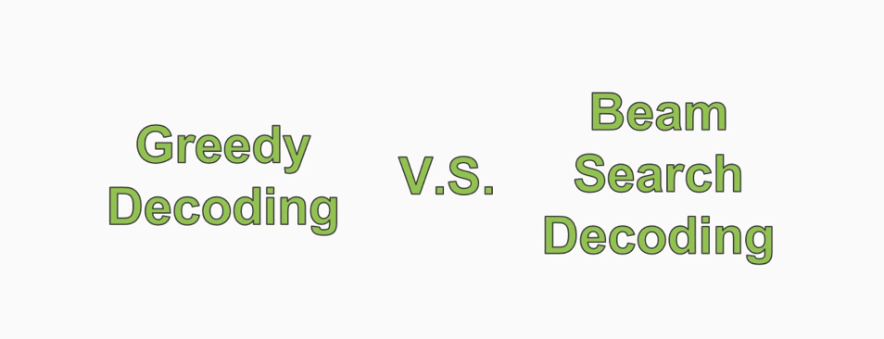
Beam Search decoding and Attention Mechanism?

Slide 30
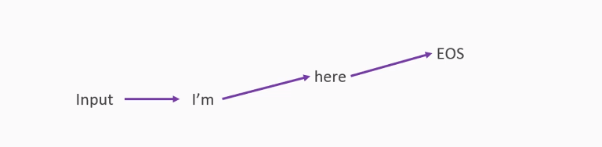
Beam Search decoding (Greedy)?
Highest probability word

Slide 31
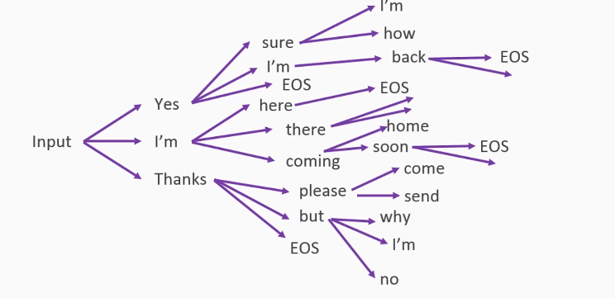
Beam Search decoding (Beam Search)?
Highest probability in Branch format

Slide 32
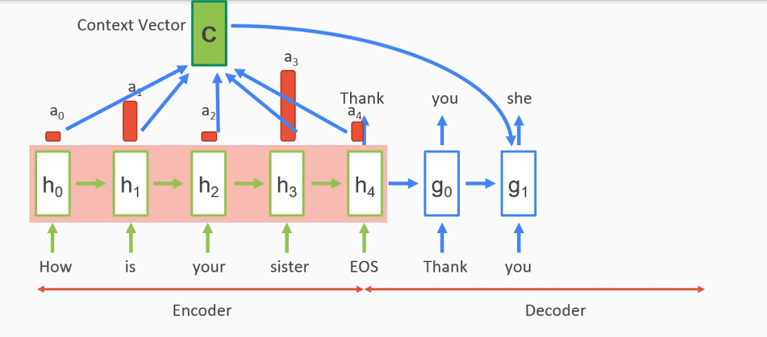
Attention Mechanism?

Slide 33
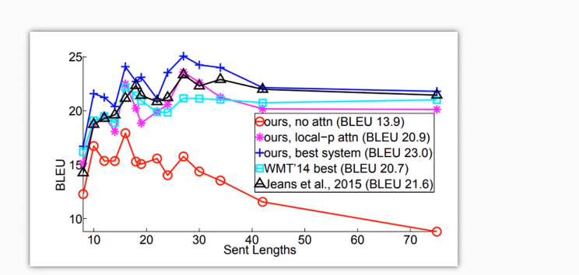
Beam Search decoding and Attention Mechanism?
Attention is not good with Seq2Seq
https://arxiv.org/pdf/1508.04025.pdf

Slide 34




Tools Used

Slide 35
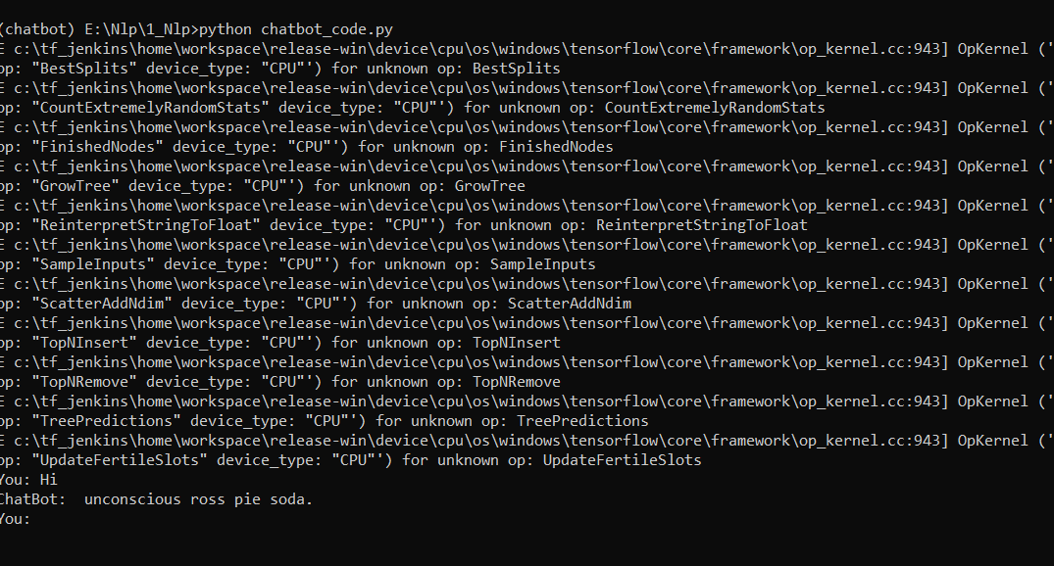
Working Code Sample

Slide 36


